Slide 1
Database Programming
Chapter 4 (Part 3)

Slide 2
What Are You Going To Learn?
At the end of this lesson, you will be able to:
use data bound controls
apply data binding to data bound controls, such as DropDownList

Slide 3
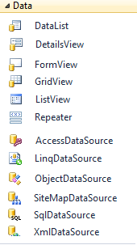
Data Bound Controls and Data Source Controls
A simple way is to use data source controls, which allow you to encapsulate data access in a control that you can configure with connection and query information.
Namespace: System.Web.UI.WebControls
data bound controls
data source controls

Slide 4
Data Source Control
The built-in data source controls
SqlDataSource
AccessDataSource
ObjectDataSource
XmlDataSource
SiteMapDataSource
LinqDataSource
EntityDataSource (not in syllabus)

Slide 5
SqlDataSource Control
The "Sql" in the control name does not refer to Microsoft SQL Server, but rather the SQL syntax for querying relational databases.
SqlDataSource control can be used to access not only Microsoft SQL Server databases, but Microsoft Access databases, Oracle databases and basically any OLE-DB or ODBC-compliant data store.

Slide 6
Data Bound Control
render data as markup to the requesting browser.
can bind to a data source control and automatically fetch data at the appropriate time in the page request lifecycle.

Slide 7
Data Bound Control (cont..)
ASP.NET includes the data-bound controls described as following:-
GridView
DetailsView
FormView
DataList
Repeater
List controls
BulletedList, CheckBoxList, DropDownList, ListBox, and RadioButtonList controls.

Slide 8
Data Bound Control (cont..)
Menu
Renders data in a hierarchical dynamic menu that can include submenus.
AdRotator
Renders advertisements on a page as an image that users can click to go to a URL associated with the advertisement.
TreeView
Renders data in a hierarchical tree of expandable nodes.

Slide 9
Overview of Data Binding
Data Binding:
Process of dynamically assigning a value to a property of a control at run time.
Example:
You can use data binding to bind the properties of a control to a data source such as the content of a Microsoft SQL Server Express table.
Data binding enables you to control exactly when a value is bound to a property.

Slide 10
Binding a Server Control to a Data Source
In this section, you will learn how to use data binding with GridView, DataList, Detailsview, FormView, Repeater, DropDownList, radioButtonList, and ListBox controls.
You will use the SqlDataSource property to bind the items from SQL Server Express Edition.

Slide 11
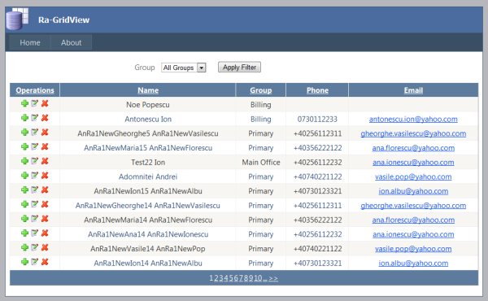
Gridview
Control displays data as a table and provides the capability to sort columns, page through data, and edit or delete a single record.

Slide 12
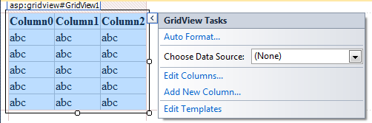
GridView
You can customize the appearance and behavior of the GridView control by doing the following:
Utilizing templates to create custom user interface (UI) elements.
Specifying custom columns and styles.
Double-click the Gridview allows you adding your own code to the functionality of the GridView control by handling events.

Slide 13
DEMO
Binding to the GridView Control

Slide 14
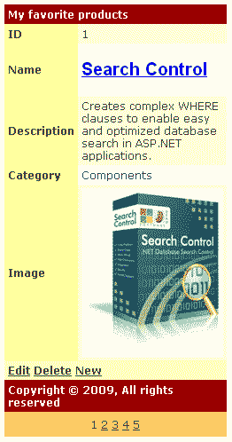
DetailsView
Renders a single record at a time as a table
provides the capability to page through multiple records, as well as to insert, update, and delete records.

Slide 15
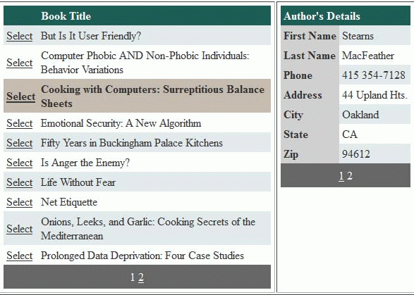
DetailsView
Often used in master-detail scenarios where the selected record in a master control such as a GridView control determines the record displayed by the DetailsView control.
DetailsView
Gridview

Slide 16
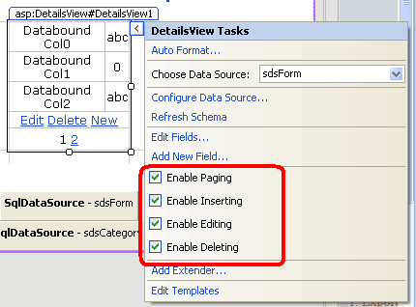
DetailsView
DetailsView offers additional customization through templates, which give you more control over the rendering of certain elements
Similar to Gridview, DetailsView offers you paging, inserting, editing and deleting command fields.

Slide 17
DetailsView
You can control the appearance of the DetailsView
The DetailView control supports the following Fields
BoundField | Displays the value of a data item as text
CheckBoxField | Displays the value of the data item as a check box
TemplateField | Customize the appearance of a data item
ImageField | Displays the value of a data item as an image
HyperlinkField | Displays the value of a data item as a link
ButtonField | Displays the value of a data item as a button, imagebutton, linkbutton
CommandField | Displays links for editing, deleting and selecting rows

Slide 18
DEMO
Binding to the DetailsView Control

Slide 19
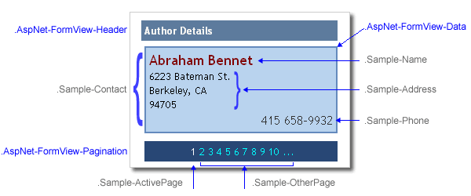
FormView
Similar to DetailsView, FormView renders a single record at a time from a data source
Different from DetailsView, FormView does not specify a pre-defined layout for displaying a record.

Slide 20
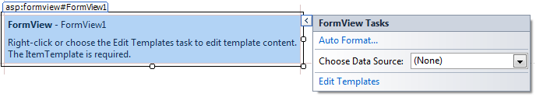
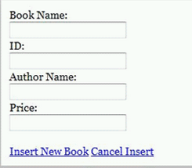
FormView
You can create templates that contain controls to display individual fields from the record
similar to the DetailsView, FormView povides the capability to page through multiple records, as well as to insert, update, and delete records,

Slide 21
DEMO
Binding to the FormView Control

Slide 22
Data-bound Controls Comparisons
Control | Data Structure | Capabilities | Description and Primary Uses
GridView | Table | Read and edit | Separate column for each field Each field value in its own cell Display multiple records in a grid Edit existing records
DetailViews | Table or Tree | Read, edit, create | Display single records Default structure provided Edit existing records Create new records
FormView | Table or Tree | Read, edit, create | Display single records No default structure Edit existing records Create new records

Slide 23
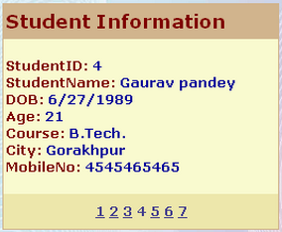
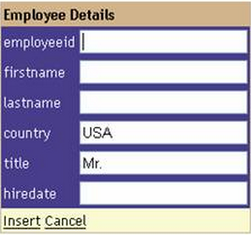
Question
Suggest the appropriate data bound control that can be used to create the following effects:
(a)
(b)

Slide 24
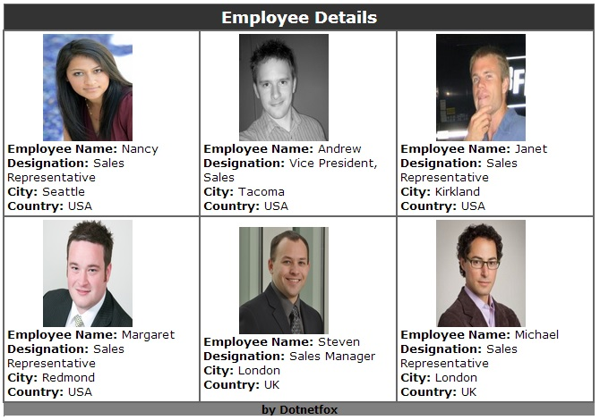
DataList
DataList control explicitly places items in an HTML table
Renders data as table and enables you to display data records in different layouts, such as ordering them in columns or rows.

Slide 25
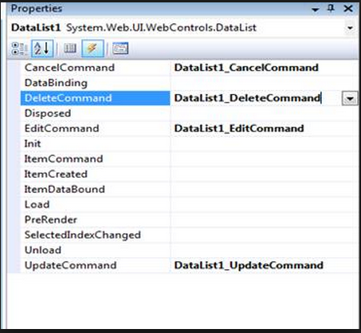
DataList
The EditCommand event is raised when the Edit button is clicked for an item in the DataList control
Datalist enables users to edit or delete a record in the table.
However DataList control does not provide the capabilities for you to modify data; you must supply this code yourself.
The UpdateCommand event is raised when the Update button for an item is clicked

Slide 26
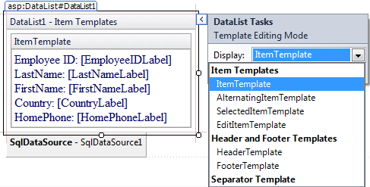
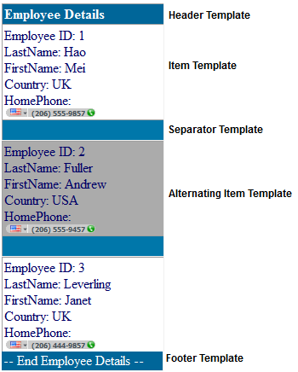
DataList
Features of the templates:
Enable you to apply complicated formatting to each of the items displayed by a control.
You can place any HTML tags that you please within a template.
A template can also contain other controls and even inline ASP.Net code.

Slide 27
Templates
Types | Description
HeaderTemplate /FooterTemplate | Contains the text and controls to render at the beginning and end o the list, respectively.
ItemTemplate | Contains the HTML elements and controls to render once for each data item in the data source.
AlternatingItemTemplate | Contains the HTML elements and controls to render once for every other data item in the data source. Typically, this template is used to create a different look for the alternating items, such as a different background color than the color that is specified in the ItemTemplate.
SeparatorTemplate | Contains the elements to render between each item. A typical example might be a line (using an <hr> element).

Slide 28
DEMO
Binding to the DataList Control

Slide 29
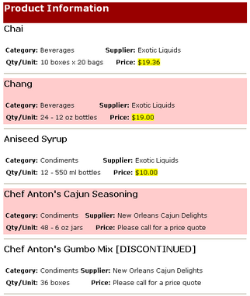
Question
fill in the names of the templates
(a)
(b)
(c)
(d)

Slide 30
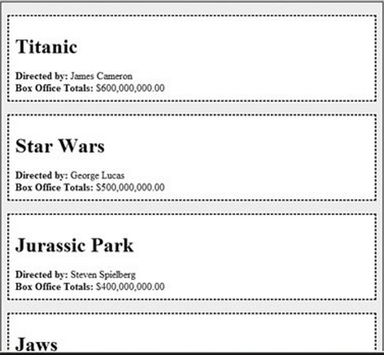
Repeater
Repeater control has no default look (while DataList places items in a table)
Repeater control allows you to define the layout of individual items on a Web page by using templates (for you to create your own custom layout to display any data)

Slide 31
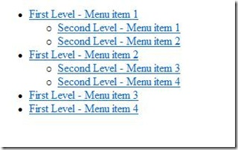
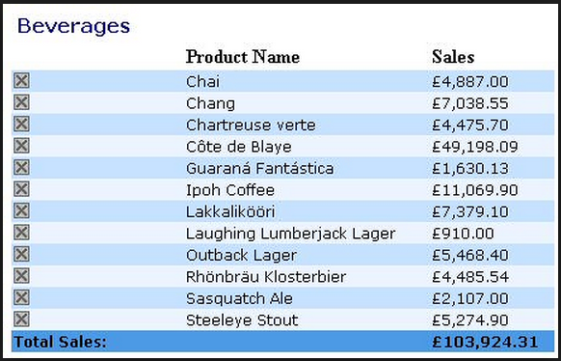
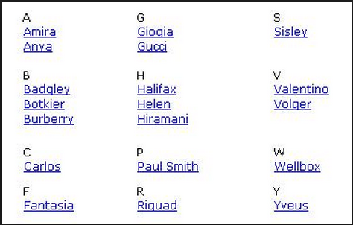
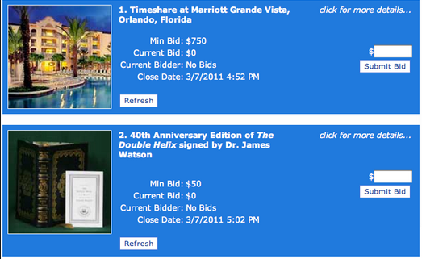
Repeater
Because the Repeater control has no default look, you can use it to create many kinds of lists, including the following:

Slide 32

Using Repeater Template
Similar to DataList, all fields are displayed in one cell on a repeater (one cell = one record)
You must use templates to control output formatting.
You may bind the data to a repeater from a DataSource control

Slide 33
Repeater
<asp:Repeater ID="Rpt1" runat="server" DataSourceID = "DataSource1" >
<ItemTemplate>
<%#DataBinder.Eval(Container.DataItem, "FirstName" ) %><br/>
</ItemTemplate>
</asp:Repeater>
Output
Critina
Artonda
Degama
Mia
Harry Prace
Kudo Dhabi
table field
custom formatting
DataBinder.Eval (object: container, string: expression)
For any of the list Web controls, such as GridView, DetailsView, DataList, or Repeater, container should be Container.DataItem. (If you are binding against the page, container should be Page)
Notes:
The <%# %> means this is a DataBinding expression and Container.DataItem is an alias for the current item in the datasource. In other words, if you are binding to a collection of objects Container.DataItem is the current row of that collection.

Slide 34
DataBinder.Eval (object: container, string: expression)
Container:
The object reference against which the expression is evaluated. This must be a valid object identifier in the page's specified language.
expression
The navigation path from the container to the property value to be placed in the bound control property.
This must be a string type of property or field names

Slide 35
Repeater
<asp:Repeater ID="Rpt1" runat="server" DataSourceID = "DataSource1" >
<ItemTemplate>
<%#Eval("LastName" )%>, <%#Eval("FirstName“)%> <br/>
</ItemTemplate>
</asp:Repeater>
Output
Anne, Critina
Joseph, Artonda
Alfanso, Degama
Mama, Mia
Greece, Harry William, Prace
Joe, Kudo
Abu, Dhabi
table fields
custom formatting
Alternatively, we can use Eval() instead of DataBinder.Eval()

Slide 36
DEMO
Binding to the Repeater Control

Slide 37
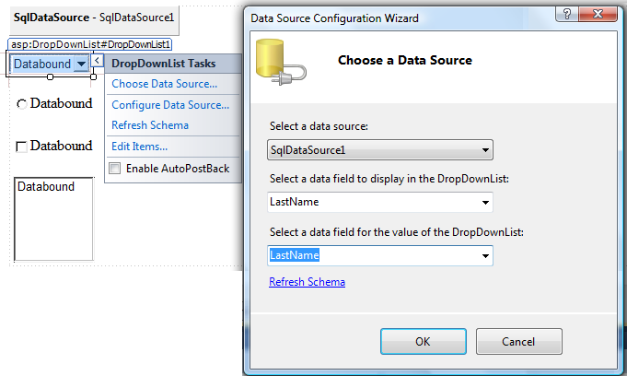
Binding to the List Controls – with DataSource control
you need to set the DataTextField and DataValueField property

Slide 38
Binding to the List Controls – with Code
Alternatively, you can write code to bind the data to the list control.
//assume that connection and command have been established
dtrEmployees = cmdSelectEmployees.ExecuteReader();
CheckBoxList1.DataSource = dtrEmployees;
CheckBoxList1.DataTextField = "lastName";
//Use DataValueField if Value != Text
CheckBoxList1.DataValueField = " EmployeeID";
CheckBoxList1.DataBind();
…

Slide 39
Question
Assuming part of the code is shown below. Discuss the problem if the page is loaded again (for the 2nd time).
void Page_Load(object sender, eventArgs e)
{
string strCon = ConfigurationManager.ConfigurationSt…….;
SqlConnection con = new SqlConnection(strCon);
…
dtrStates = cmdSelectState.ExecuteReader();
ddlState.DataSource = dtrStates;
ddlState.DataTextField = “state";
ddlState.DataBind();
con.Close();
dtrStates.Close();
}
Notes:
One thing you should notice about the page_load( ) event handler should use the IsPostBack property to check whether the page has already been submitted.
Therefore the database records are retrieved and bound to the DropDownList control when the page is first opened, but not thereafter, since the list of states is preserved in the page’s view state when the page is posted back to the server.
You need to retrieve the records from the database only the first time the page is opened, and the records will be preserved in the page’s hidden – VIEWSTATE form field.

Slide 40
Binding to the List Controls – with Code
What happen if neglecting the IsPostBack property:
Decrease the performance of the page because the records need to be retrieved from the database every time the page is opened. Retrieving records from a database is a resource-intensive task.
if a user selects an Employees from the DropDownList control, and you rebind the DropDownList to the database table, the user’s selection is lost. Binding a DropDownList resets the SelectedIndex and SelectedItem properties of the control.

Slide 41
Data-bound Controls Comparisons
Control | Data Structure | Capabilities | Description and Primary Uses
DropDownList, ListBox | Table or Tree | Read only | List of few fields
DataList | Table or Tree | Read and edit | All field in one cell One cell equals one record Display multiple records in a grid Create new record for GridView
Repeater | Table or Tree | Read only | All field in one cell One cell equal one record Display multiple records in a grid. Create new record for GridView display

Slide 42
MEMBERSHIP AND ROLE MANAGEMENT
Next Week

